Slide 1
The land of math
We invite everybody to solve Baltic sea exercises!

Slide 2

1. We are getting ready for a huge trip around the Baltic Sea. We decided to visit at least one city from every Baltic country. We will start the trip in Klaipeda:
We are thinking of getting to Gdansk, located Poland, from Klaipeda by bicycles ( ̴220 km).

Slide 3
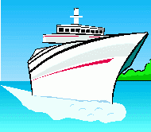
Then from Gdansk we will sail to Kiel on a boat
( ̴520km).

Slide 4
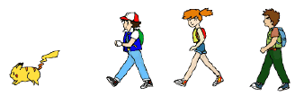
We will get From Kiel to Kolding which is in Denmark on foot ( ̴170km).

Slide 5
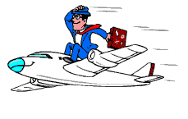
From Kolding to Stockholm, the capital of Sweden, we will fly by plane ( ̴800km).

Slide 6
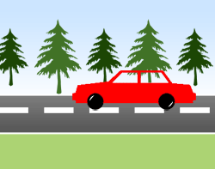
We will reach Helsinki, in Finland, by car ( ̴840km).

Slide 7

After that we will “fly” from Helsinki to Tallinn which is in Estonia on a high-speed ferry ( ̴85km).

Slide 8

Then from Tallinn to Ventspils we will sail on a yacht ( ̴400km).

Slide 9

Finally, we will get back from Ventspils to Klaipeda by a bus ( ̴210km).

Slide 10
How long will our trip take?
Average vehicle speed:
Bike 11km/h
On foot 5km/h
Boat 50km/h
Plane 800Km/h
High-speed ferry 85km/h
Yacht 40km/h
Car and bus 105km/h

Slide 11
Solution
Klaipeda — Gdansk 220km; 11km/h; 20h
Gdansk — Kiel 550km; 50km/h; 11h
Kiel — Kolding 170km; 5km/h; 34h
Kolding — Stockholm 800km; 800km/h; 1h
Stockholm — Helsinki 840km; 105km/h; 8h
Helsinki — Tallinn 85km; 85km/h; 1h
Tallinn — Venstpils 400km; 40km/h; 10h
Ventspils — Klaipeda 210km; 105km/h; 2h
_________________________
87h

Slide 12

In total, we will travel 87 hours or 3 days and 15 hours.

Slide 13
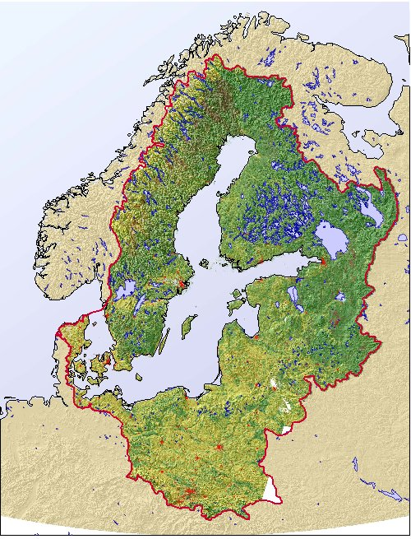
2. Which of the Baltic countries have the longest coastline?

Slide 14
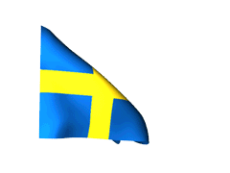
Sweden

Slide 15
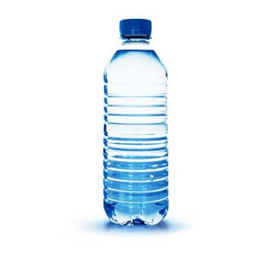
3. The volume of the water in the Baltic Sea is 21000 km3.
a) How many bottles would it take to pour it all into 1l bottles?

Slide 16
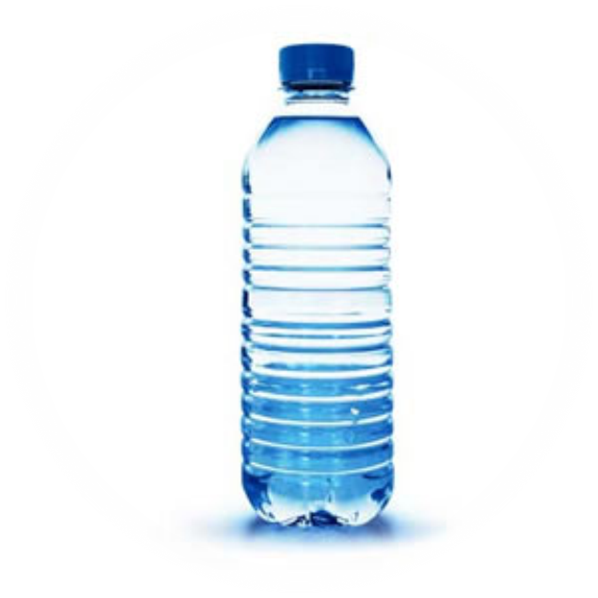
Solution
21000 km³ = 21000 x 10¹² dm³ = 21 x 10¹⁵ l
Answer
21000000000000000 or 21 x 10¹⁵ bottles

Slide 17
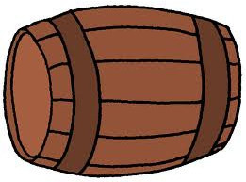
b) And if into 200l barrels?

Slide 18
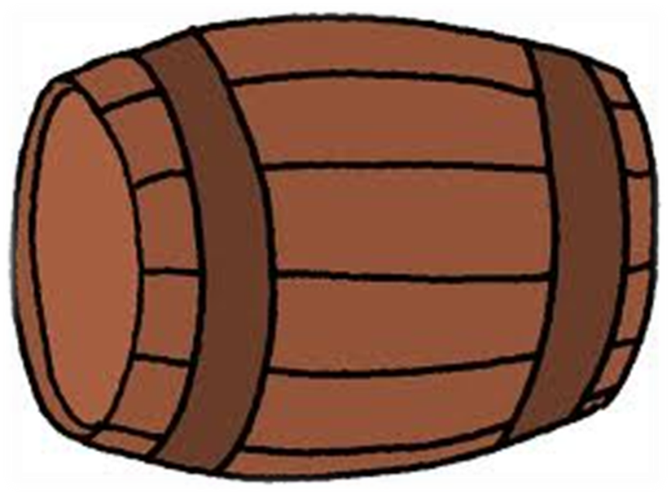
Solution
21 x 10¹⁵ : 200 = 25 x 10¹²
Answer
25 x 10¹² barrels

Slide 19
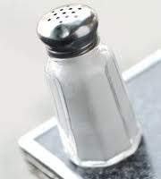
4. The salinity of the water in the Baltic Sea is about 1.7%. How much kilograms of salt would we get, if we evaporated the water?

Slide 20
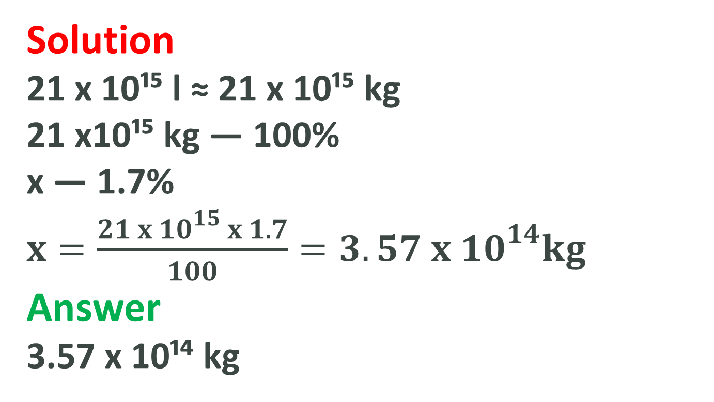
Solution
21 x 10¹⁵ l ≈ 21 x 10¹⁵ kg
21 x10¹⁵ kg — 100%
x — 1.7%
$x=\frac{21 x {10}^{15} x 1.7}{100}={3.57 x 10}^{14}kg$
Answer
3.57 x 10¹⁴ kg

Slide 21
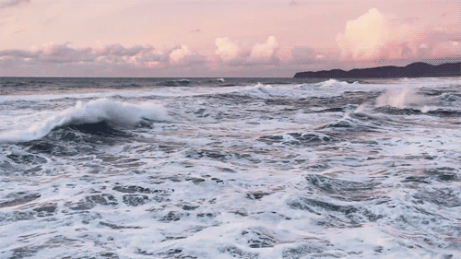
5. What percent of the combined surface area of Baltic countries does the surface area of the Baltic Sea consist?

Slide 22
Surface area of the Baltic Sea 386 000 km2
Surface area of Baltic countries
Lithuania 65200 km2
Poland 312689 km2
Denmark 43094 km2
Estonia 45226 km2
Latvia 64589 km2
Finland 338145 km2
Germany 357112 km2
Sweden 449964 km2

