Slide 1


Slide 2
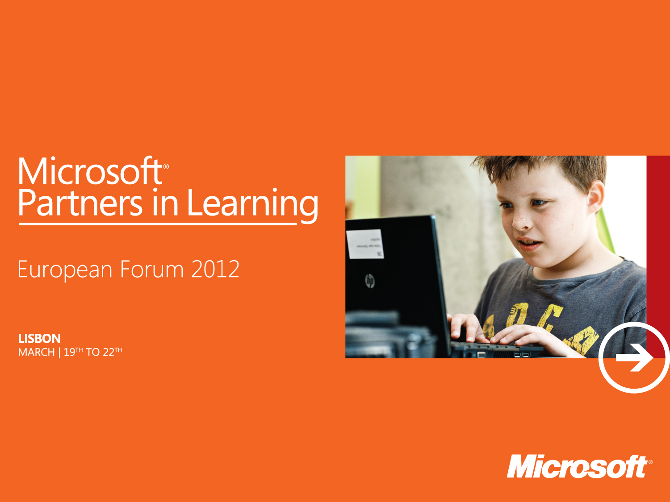
Virtual Classroom Tour - VCT

Slide 3

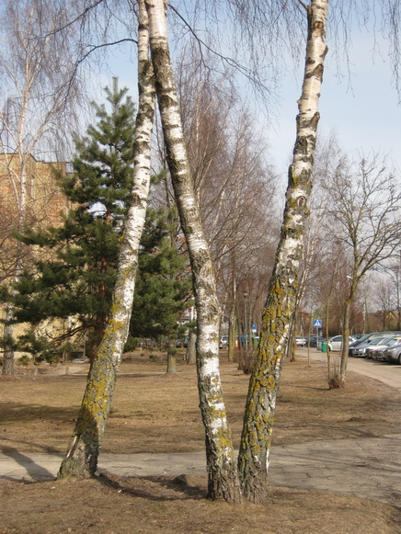

Letters from the nature
Educator(s) | SIGITA KOROLIOVE
School | Klaipeda‘s deaf and hearing impaired main school
School Website | www.kurtieji.lt
Content/Subject Areas | Environmental education, Informatics/ICT, English language, Geography
Age/Grade level | 12-16 years
Project Objectives | Kids dedicate the environmental Project “Letters from the nature” to people that are unable to see the beauty of nature. In order to stop people from destroying the nature, pupils addressed them with letters found in trees, rocks, clouds, water reservoirs, birds and animals... Pupils spelled the name of their countries from the found letters and placed them on calendars and book markers of their own creation, in order to remind people how fragile the nature is.

Slide 4
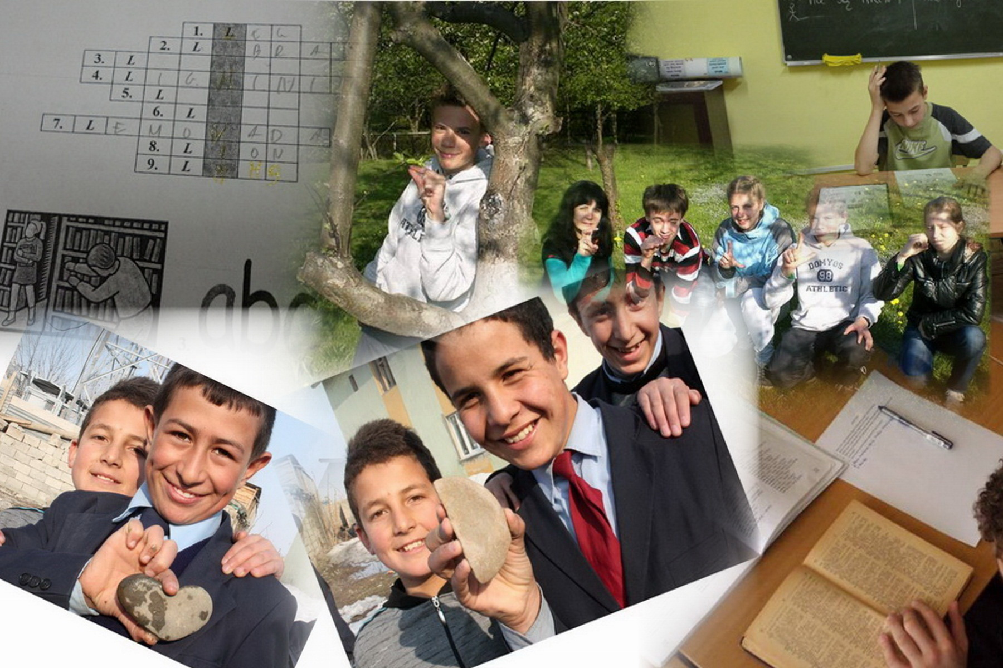
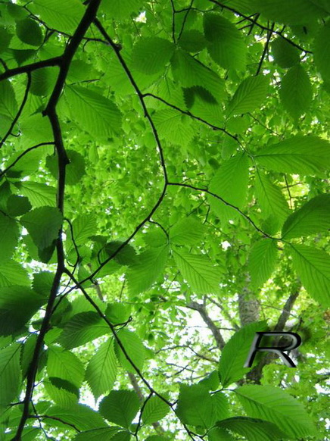
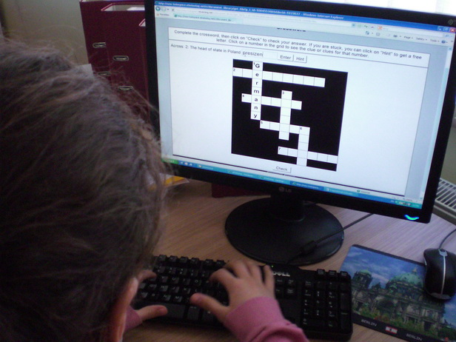
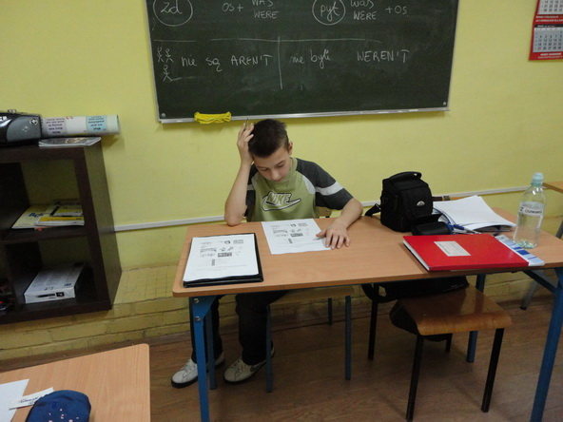

Project Description http://korsigita.wordpress.com/2012/02/26/laiskai-is-gamtos-letters-from-the-nature/ Design of the Learning Environment http://www.kurtieji.lt/index.php?mod=projects&type=2&id=82 http://www.kurtieji.lt/index.php?mod=projects&type=2&id=91
The capital city of Poland?
We found half a moon and a heart in Turkey!
What a difficult crossword made by Lithuanians!
Notes:
To embed a project resource or materials
Have the resource document available. From the Insert menu choose Object.
Select Create from File… and click Browse…. Find the file you want to include and click OK.
Select Display as icon and click Change Icon… and add a suitable caption.
Click OK to add the caption and click OK to embed the file. Use the Action button on the Insert ribbon to activate the object.
Use Hyperlinks to link to websites, audio and video that show . Do not embed video or audio, use links to video hosting sites or your school site.
Open the Word documents by double clicking the icons. Clicking Save in Word will save the changes.
Please ensure that you have the full permission to use any images and video, as this project will be in the public domain.

Slide 5
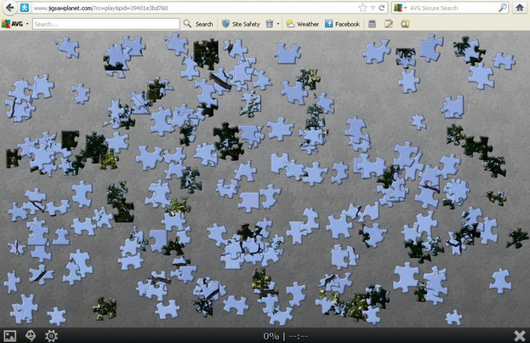
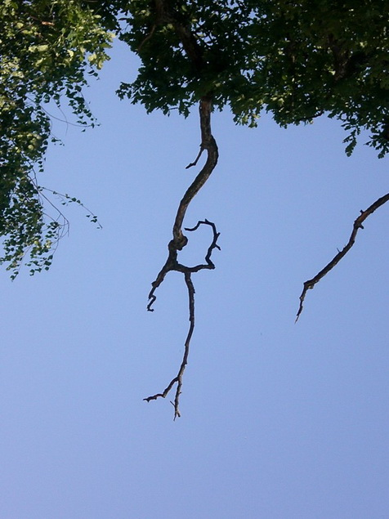
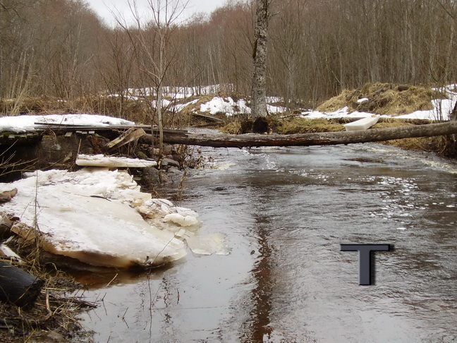
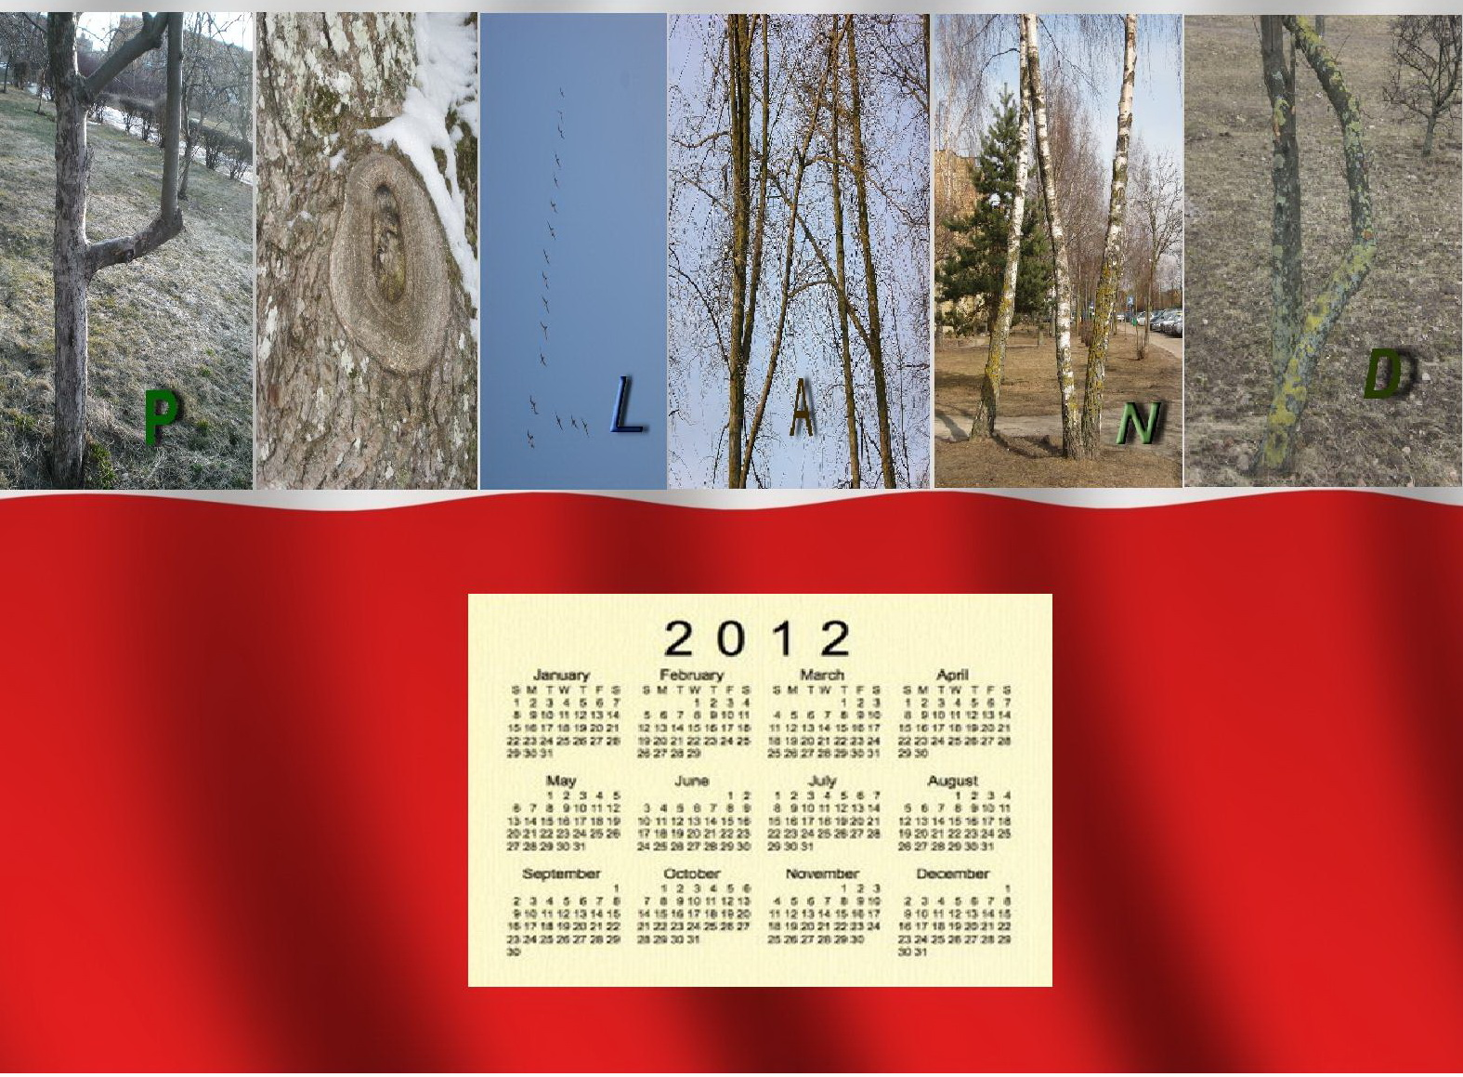
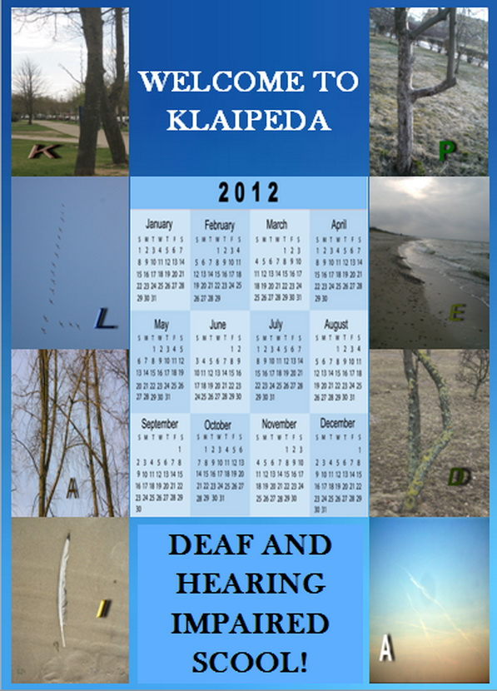
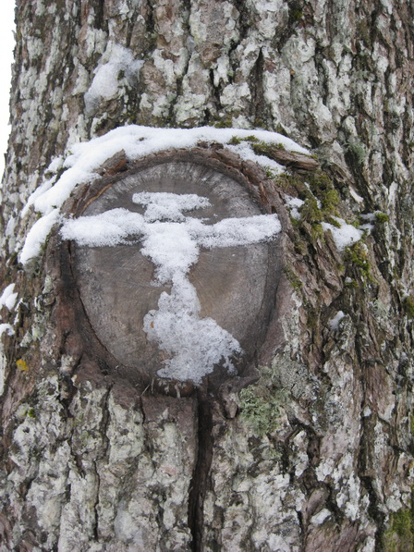
Evidence of Learning http://www.kurtieji.lt/index.php?mod=projects&type=2&id=80 http://www.kurtieji.lt/index.php?mod=projects&type=2&id=81
The letters from the Estonian forest

Slide 6
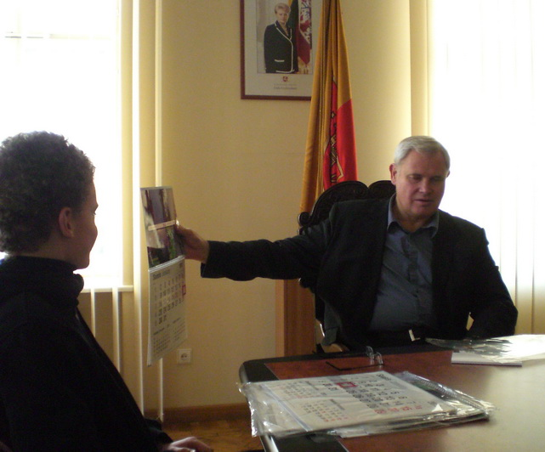

Knowledge Building & Critical Thinking http://www.kurtieji.lt/index.php?mod=projects&type=2&id=93 http://www.kurtieji.lt/index.php?mod=projects&type=2&id=94 Extended Learning Beyond the Classroom http://www.kurtieji.lt/index.php?mod=projects&type=2&id=92 http://www.kurtieji.lt/index.php?mod=projects&type=2&id=78 http://www.kurtieji.lt/index.php?mod=projects&type=2&id=88 http://www.kurtieji.lt/index.php?mod=projects&type=2&id=87 | The Project Letters from Nature is not only environmental, educational and multicultural but also social project inviting parents to spend more time with their children. This Project is a great example of how real life problem and concern - to preserve the nature - could be escalated and with little steps solved when integrated in different subjects and after-classes activities, how it can involve the whole school community and parents and extend the learning beyond the classroom.
The mayor of Klaipeda acknowledged the fact that he is unable to spot letters in nature.

Slide 7

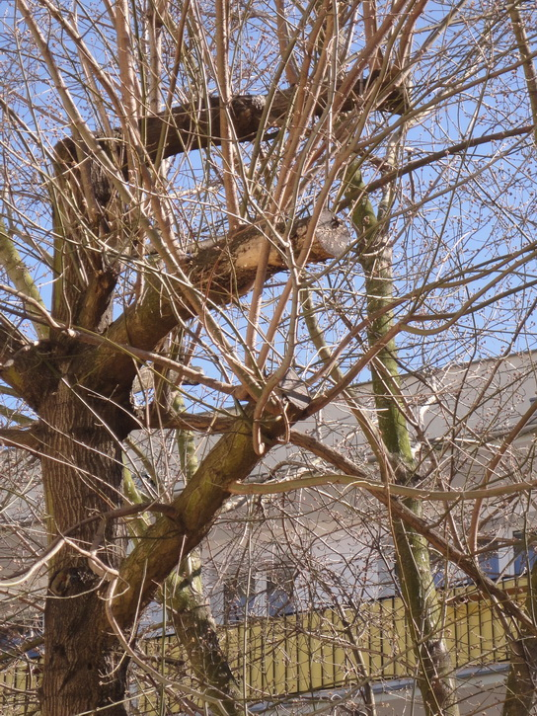
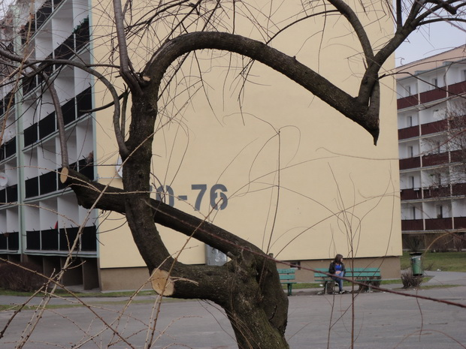
Collaboration http://twinblog.etwinning.net/33809/ http://www.kurtieji.lt/index.php?mod=projects&type=2&id=84 http://www.kurtieji.lt/index.php?mod=projects&type=2&id=92
The Project Letters from Nature is a great example of ICT skills learning and improving by doing - little different steps, like: photoshooting, picture editing, creating videos, making presentations and presenting, creating interactive tasks for younger pupils, communicating virtually with peers from different countries, with different programs designing calendars and other marketing material from the letters, gathered, etc. - taken towards important goal - preserving the environment.
The success of the Project allowed for an understanding that it will be easy to gather a great team for future activities from: our own pupils, colleagues and eTwinning participants, because good ideas, coherent work, sincere support in collaboration with the Project participants and people that feel for them, unique works and problem solving provided confidence in their strengths to organize and plan activities inside and outside of the school, and modern ICT allowed the ideas to be spread around Europe that will not be forgotten, because the college from Turkey Gülsüm Şahbaz asked for the permission to put the Project in Comenius activity.
All leters
https://skydrive.live.com/?cid=7D209BDA338645B3&id=7D209BDA338645B3!140

